Slide 1
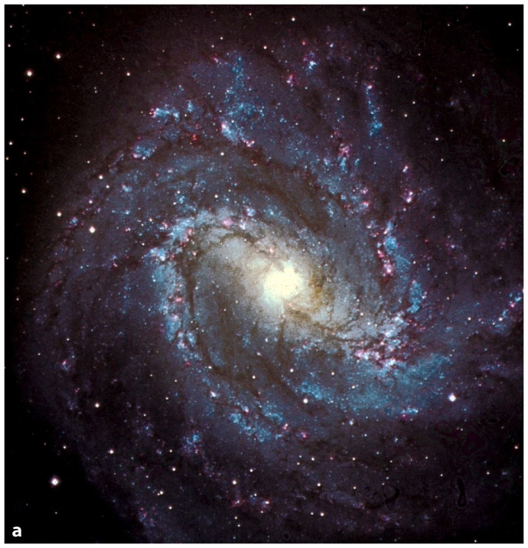
PHAS 1102/1423
THE EXTRAGALACTIC
DISTANCE SCALE

Slide 2

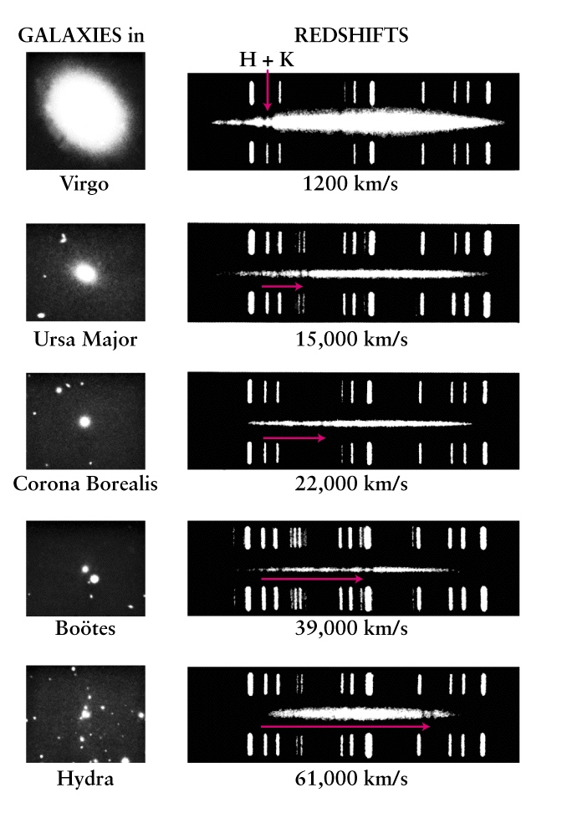
All distant galaxies are receding;
their spectra are red shifted
Edwin Hubble

Slide 3
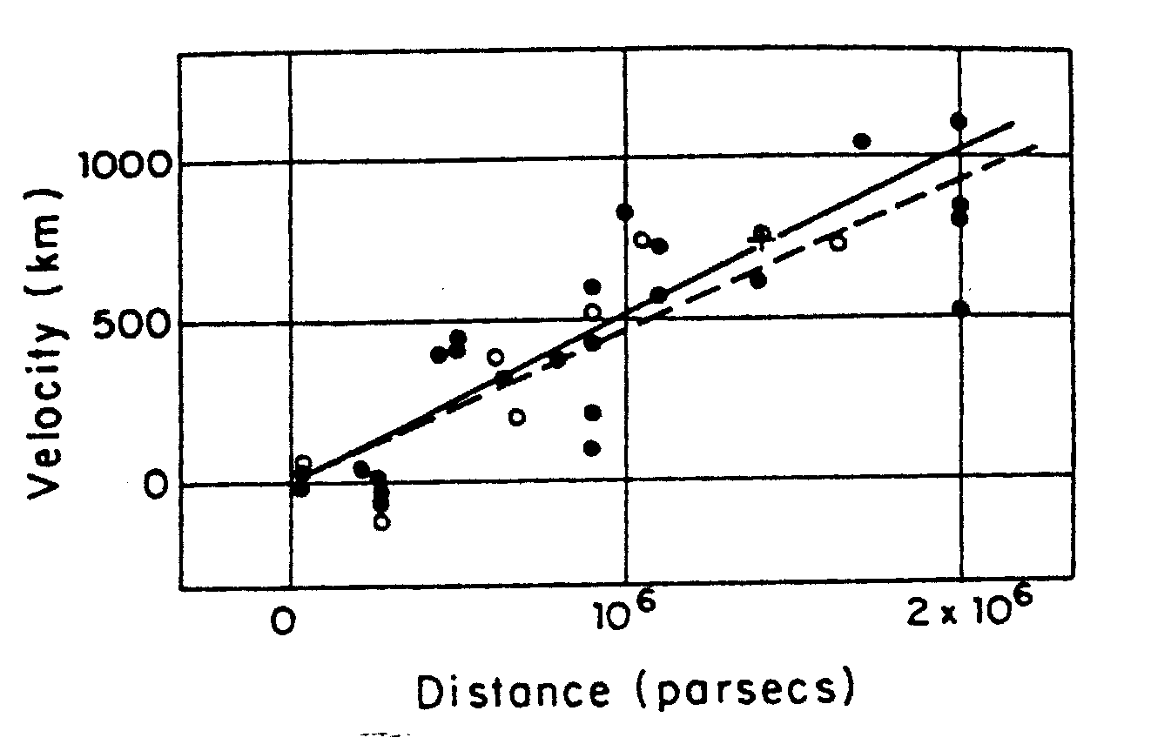
Hubble showed that this velocity of recession is proportional
to distance: Hubble’s Law

Slide 4
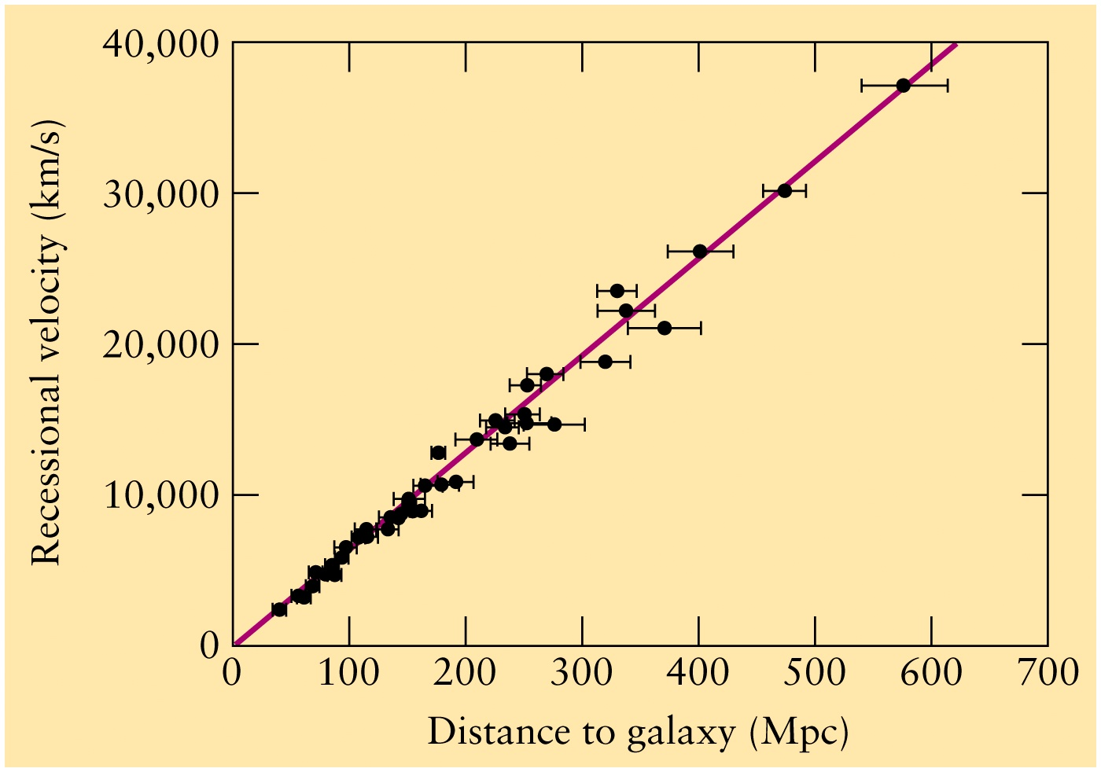
H₀ = 72 (+/-5) km/s per Mpc

Slide 5
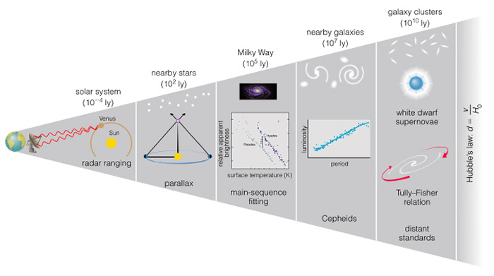
The ‘distance ladder’

Slide 6
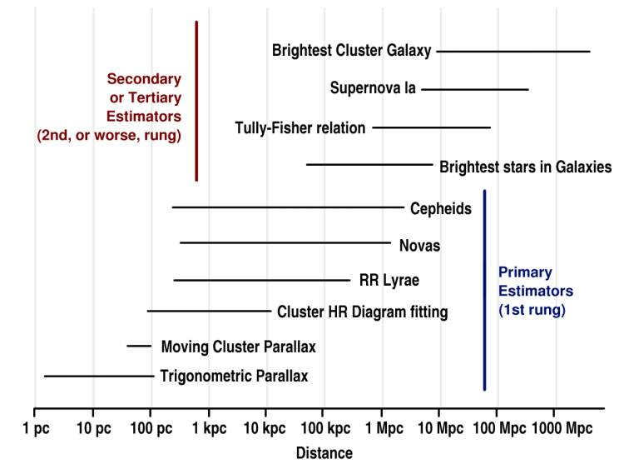
(An alternative representation of the ‘distance ladder’)

Slide 7
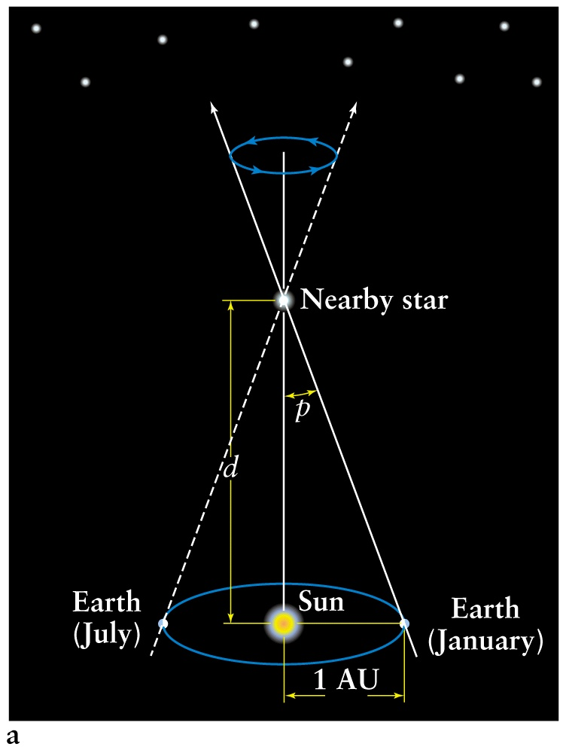
Recall distances are
measured in parsecs:
A star at 1 parsec has a
parallax of 1 arcsecond
d(pc) = 1/parallax
(bigger parallax =
nearer star)
atto = 10⁻¹⁸; apc = 3cm

Slide 8
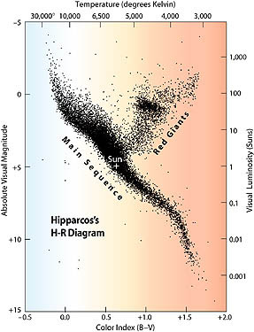
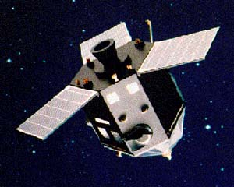
Hipparcos: HIgh Precision PARallax Collecting Satellite
(not “Hipparchus”!)
120,000 stars to a few mas
(i.e., distances to a few hundred
parsec) => HR diagram

Slide 9
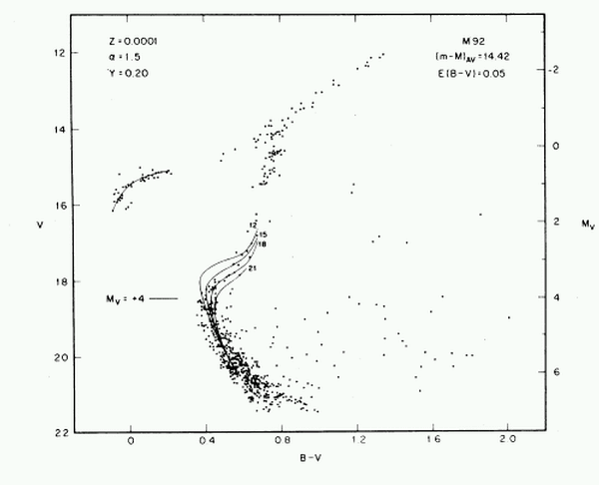
Main-sequence fitting
(& spectroscopic pllx)

Slide 10
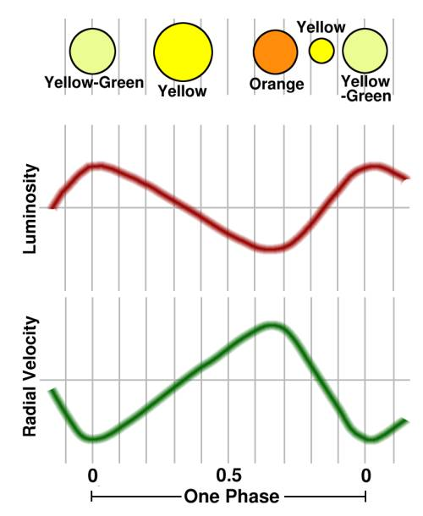

Cepheid variables are pulsating stars:
Roughly speaking,
small but hot when bright
big but cool when faint

Slide 11
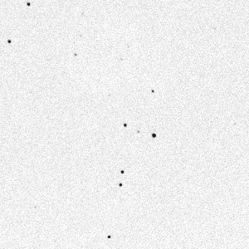
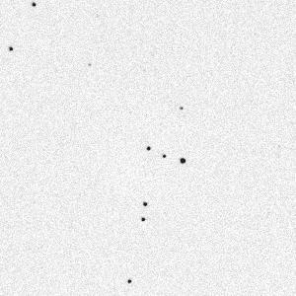

Henrietta Swan Leavitt (ca. 1912), studying stars in the Magellanic
Clouds, found a number of Cepheid Variables
Leavitt |
| Cannon

Slide 12
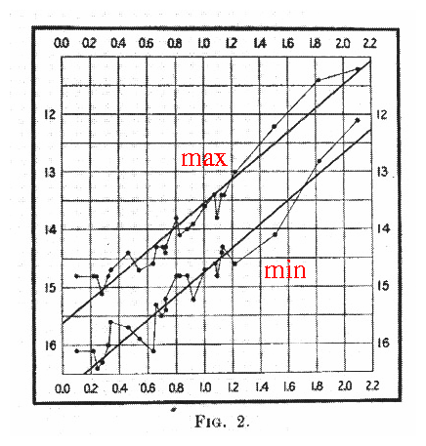
Among Magellanic Cloud
Cepheids, Miss Leavitt
found a
Period-Luminosity relationship
“The two resulting curves, one for maxima and one for minima, are surprisingly smooth, and of remarkable form. In Figure 2 ... a straight line can readily be drawn among each of the two series of points corresponding to maxima and minima, thus showing that there is a simple relation between the brightness of the variables and their periods ... Since the variables are probably at nearly the same distance from the Earth, their periods are apparently associated with their actual emission of light”

Slide 13
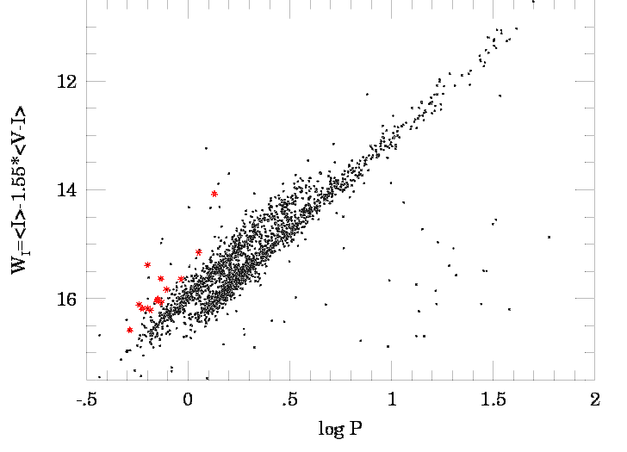
Modern version (two types of pulsator):

Slide 14
How do we calibrate the zero-point of the
period-luminosity relation?
Galactic Cepheids:
  Parallaxes
  Cluster fitting
  Baade-Wesselink
Or
  Independent LMC distance determination

Slide 15
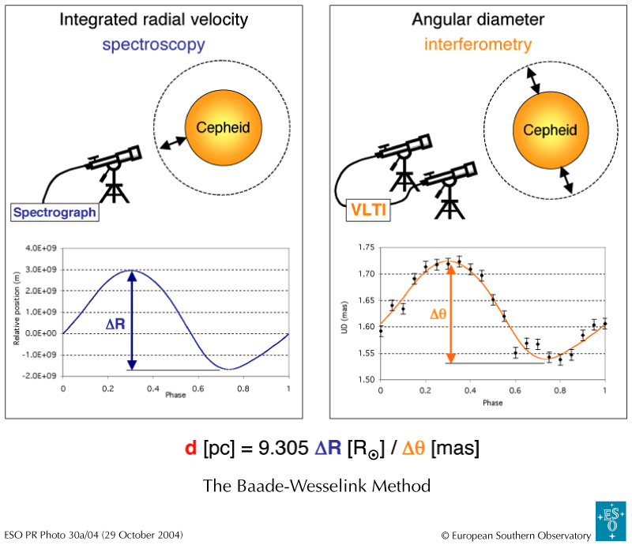

Slide 16
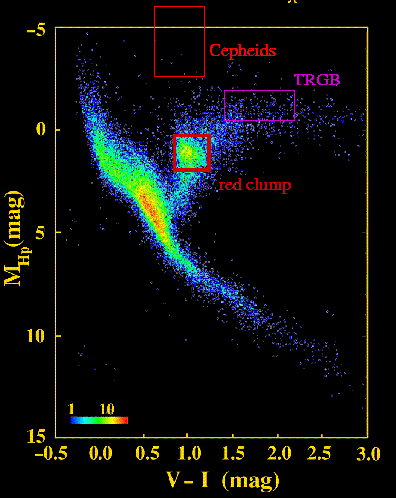

Distance to the Magellanic Clouds:
Calibrate Cepheids in Galactic clusters => PLC zero-point;
Cluster main-sequence fitting;
‘tip of the RGB’ / ‘red clump’
SN 1987A…
Lead to Period-Luminosity relation:

Slide 17
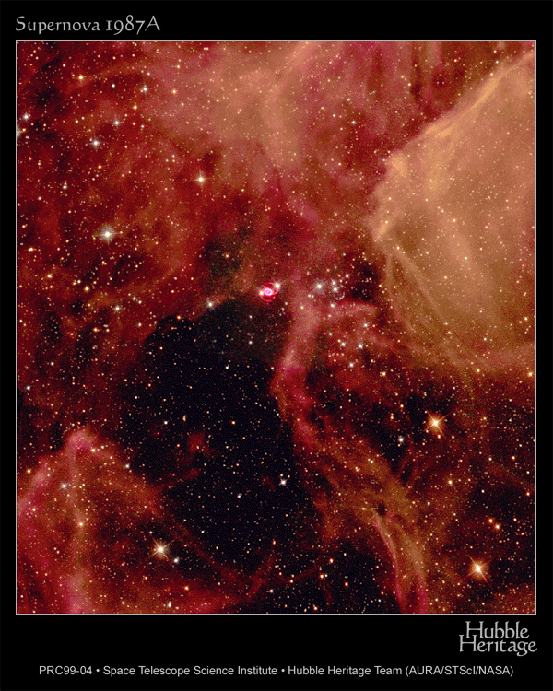
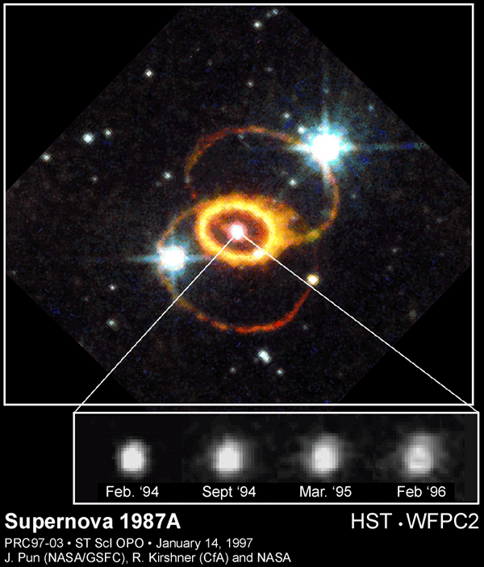
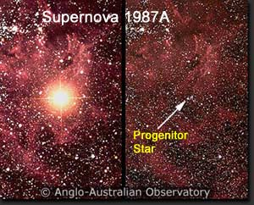
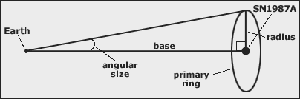
SN 1987A geometric distance

Slide 18
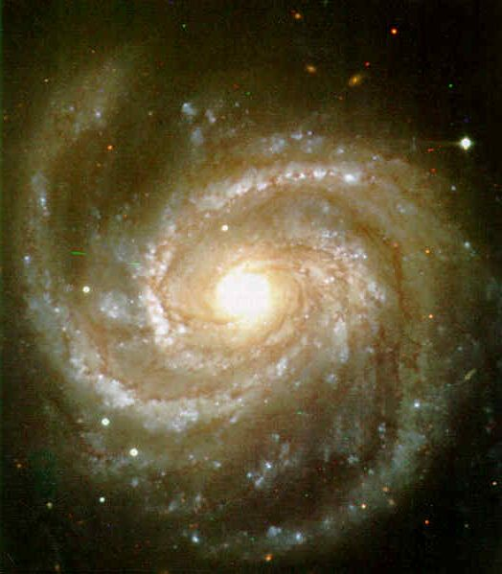
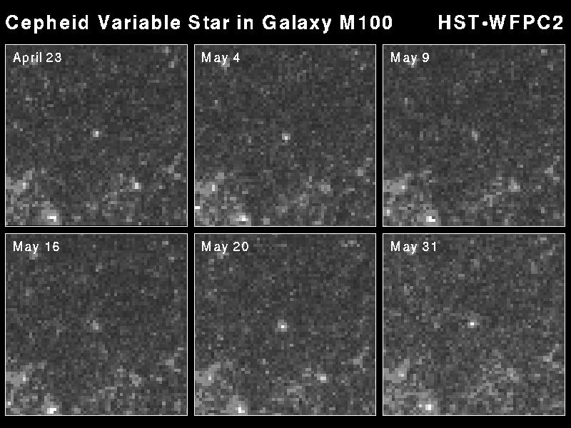
We can see Cepheids in distant galaxies

Slide 19
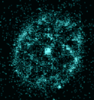
Cepheids allow distances to be determined to galaxies in which
bright stars can be resolved.
Other techniques for such galaxies:
Novae ( have roughly the same absolute magnitude 15 days after their peak [-5.5]; + nova-shell expansion )
Brightest stars
Eclipsing Binaries (primary technique!!)
Thereafter: ‘Galaxy methods’ (increasingly approximate;
the ‘distance ladder’)

Slide 20
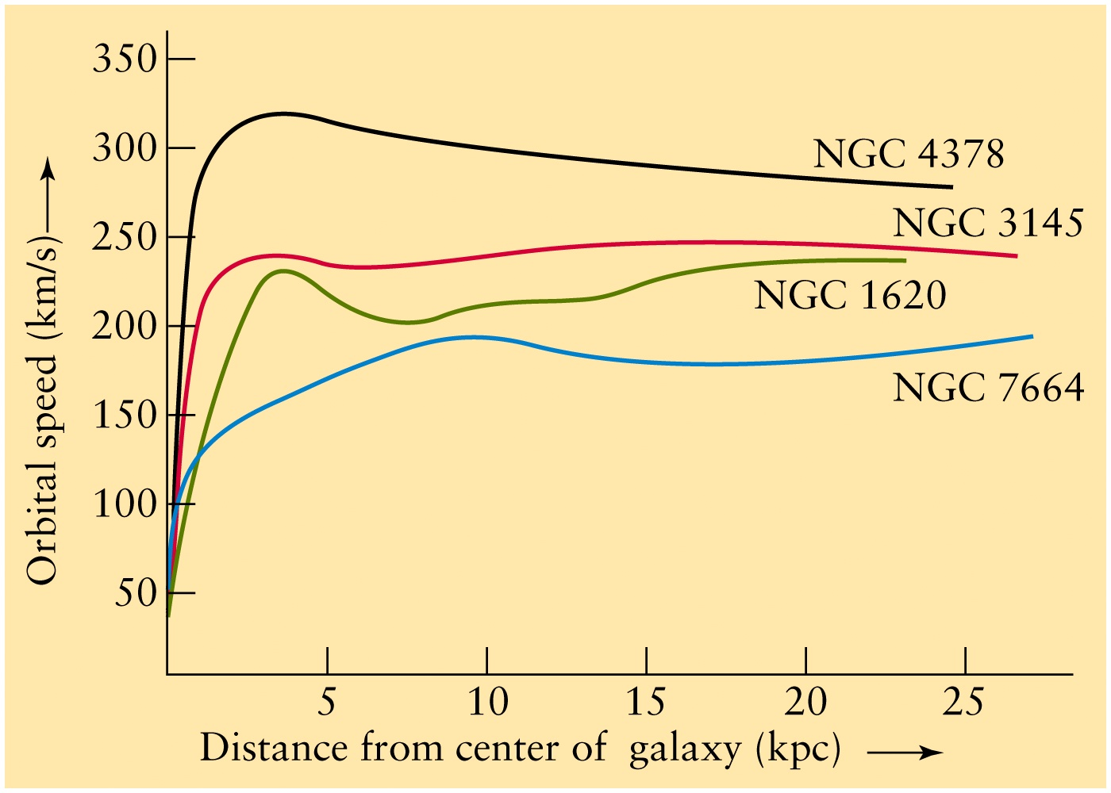
Recall rotation curves for spiral galaxies; each has a characteristic rotation velocity

Slide 21

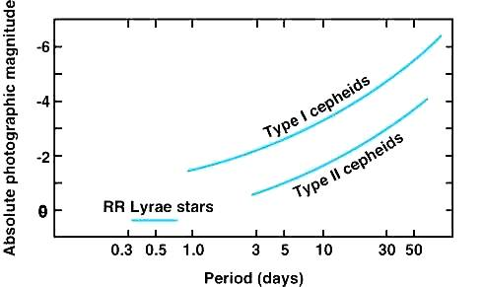
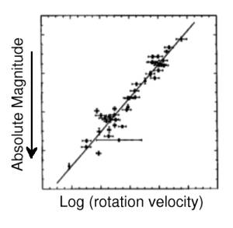
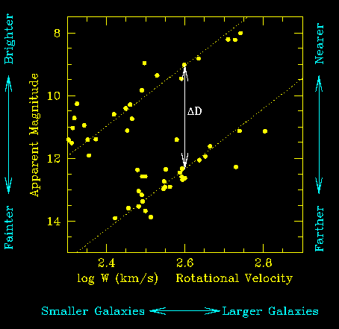
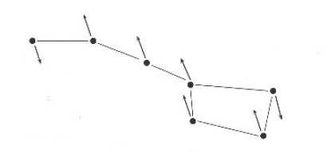
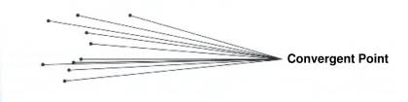
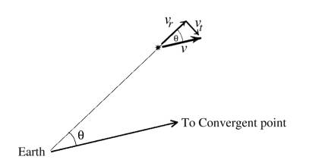
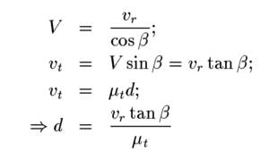
The Distance Scale
The Distance Ladder
The process of determining distances to astronomical objects is fraught with difficulty. The concept of a distance ladder is employed - the distance of the nearest objects are determined using one method, then these distances are used to calibrate another method which works out to larger distances, and so on... rung by rung up the ladder - see the figure (for further reading see Measuring the Universe, by S. Webb, published by Springer, 1999).
The Distance Ladder Some of the main types of distance estimator and their approximate ranges.
There are two basic techniques:
Geometrical methods:
  Extension of geometrical methods used on Earth such as radar and surveying. Intrinsically accurate but because they rely on light-travel effects or measuring angular displacements their range is limited.
'Standard candles':
  If one can identify objects which are believed to be of the same intrinsic brightness, then their relative brightness tells you how far away they are with respect to each other i.e. if one is 4 times fainter than the other then it is twice as far away. This depends crucially on how standard the standard candles are (200 years ago Herschel assumed all stars were the same intrinsic brightness!). It must also be calibrated by accurately determining the distance of at least one of the standard candles by another method e.g. geometrical.
We now believe that absolute distances out to the largest scales are only uncertain to a factor of about two. Relative distances are known much better than this. Here, we will consider a few of the important distance determination techniques.
Radar - the scale of the solar system
  Powerful interplanetary radars, developed in the 1960's, allow us to bounce radar beams off the inner planets such as Mercury and Venus, measure the time delay and hence work out the distance (we know the speed of light to high precision). The distances to other planets can then be calculated using Kepler's third law relating semi-major axes of orbits to periods. For example, by measuring the distance to Venus at a time when it is at its maximum angular distance from the Sun (the angle Earth-Venus-Sun is 90 degrees, the angle Sun-Earth-Venus is the angular separation of Venus from the Sun) we can easily work out the distance from the Earth to the Sun - the Astronomical Unit, the baseline for the next method.
Trigonometric parallax - the nearest stars
  We have already discussed this technique which relies upon measuring the apparent motion of nearer stars against a distant background of stars as the Earth moves around the Sun. The distance is given by d=1/p where d is in parsecs and p is in arcseconds.
RR Lyraes in globular clusters - the centre of the galaxy
  RR Lyrae stars are pulsating variables which vary in brightness with periods of about half a day. They are giants which lie on the horizontal branch and therefore are all about the same intrinsic luminosity i.e. they are standard candles.
  They are used to determine distances to globular clusters in our galaxy and hence help determine their ages. This provides a useful lower limit on the age of the universe. They can also be seen in nearby galaxies although they are too faint to be of much use beyond the local group. The only RR Lyrae to have its distance measured by Hipparcos is RR Lyr itself.
  The distances to RR Lyraes in the solar neighbourhood has been determined by statistical parallax (measuring the proper motions of many stars and averaging to leave only parallax effects due to the motion of the Sun through the galaxy) and their absolute visual magnitude is estimated as M_{V} ~ 0.7. The distance of a globular cluster can then be determined by measuring the apparent magnitudes of RR Lyraes within it and using the distance modulus.
  Shapley noticed that the globular clusters were not distributed evenly across the sky but were concentrated towards the constellation of Sagittarius. He argued that this indicated they were symmetrically placed about the galactic centre and therefore that the mean distance to the globular clusters would be the same as the distance to the galactic centre. Using RR Lyrae stars this works out to be about 9 kpc.
Cepheid variables - out to the Virgo cluster
  RR Lyrae stars can be seen within our galaxy and in the nearest other galaxies. However, they are too faint to be seen at greater distances. To extend the distance scale we therefore use another class of brighter pulsating variable - the Cepheids - the brightest of which are 10,000 times brighter and can be seen 100 times farther away than the RR Lyraes.
  The Cepheid variables are F-K supergiants (named after their prototype δ Cephei) occupying a section of the HR diagram higher up the HR diagram than the horizontal branch called the instability strip. They show asymmetric variations in brightness and radial velocity which are a result of pulsations with periods in the range 1-80 days.
A Phase of Cepheid Variability The light curve and radial velocity curve of a typical Cepheid. At the top you can see how Cepheids vary in colour and size (both the colours and size variations have been exaggerated for clarity). In the middle is the light curve and at the bottom the radial velocity curve of the Cepheid. Note how the brightness of the Cepheid increase much more rapidly than it decreases.
The most important fact regarding Cepheids is the Period-Luminosity relationship. It turns out that for the Cepheids L is proportional to P and hence the longest-period variables are extremely luminous and can easily be seen in many other galaxies. There are two main classes of Cepheid - Type II Cepheids are found in globular clusters and are fainter for a given period by about 1.5 magnitudes (a factor 4 in brightness) than the Type I Cepheids found in open clusters. For example, the Type I P-L relationship is given by:
Type I refers to Population I stars which are of similar chemical composition to the Sun, whereas Type II are Population II stars which are of lower metallicity because they are older and were formed out of material of more primordial chemical composition i.e. not processed through a previous generation of stars.
So, a measure of the period would tell us the luminosity and hence the distance from the apparent magnitude. However, We need the gradient and zero-point of the P-L relationship i.e. we need to calibrate this relationship.
For the Type-II Cepheids this is easily done because they are found in globular clusters whose distance can be determined using RR Lyrae stars - as can be seen from the figure the P-L relationship for these two types of variable is essentially continuous.
 | Period/Absolute magnitude ranges of Cepheids and RR Lyraes
Tully-Fisher:
rotation velocity
proportional to
galaxy luminosity
For the Type-I Cepheids we need another method because RR Lyrae stars are never found in open clusters. Traditionally, this is a two-step process, the first of which is a geometrical method...
Moving cluster parallax
  Stars in a cluster are believed to have been born from the same cloud and hence are moving in parallel tracks through space. This means that if we follow their motion on the sky for a time (their proper motions) they appear to converge (or diverge) from a point.
Observations of proper motions of stars in the plough show that middle stars belong to a single cluster. The two end stars are unrelated to the cluster and each other.
Due to perspective, the stars in a cluster will appear to be moving towards (or away from) a particular point on the sky.
If we know the convergence point, we can calculate the radial and transverse components of the velocity of a cluster star.
We can measure the angle β between a star in the cluster (NB this is equivalent to angle θ in the figure) and the convergent point. We can also measure the radial velocity of the star from its Doppler shift, v_{r}, and the proper motion (angular speed on the sky) μ_{t}. Then, if the actual speed of the star is V,
This can be done for all stars in the cluster to give an accurate distance estimate and a measure of the spread in distance. Unfortunately, the only cluster with a really well-determined distance by this method is the Hyades cluster, near Aldebaran in Taurus. Its distance is 46 pc. Since it contains no Cepheids it can't be used to directly calibrate the P-L relationship. However, its distance can be used in the next method to determine the distances to open clusters which do contain Cepheids!
Main-sequence fitting
  Theoretical models show that all unevolved stars of the same chemical composition lie on the same locus in an HR diagram - the Zero Age Main Sequence (ZAMS - see earlier lecture on cluster HR diagrams ). For the Hyades (or in actual fact for a composite cluster made up of the best measurements for a few nearby open clusters) we have a ZAMS in the M_{V}/B-V plane. For other clusters we would have only m_{V}. Hence all we need to do is overlay the HR diagrams and slide them vertically until the main sequences exactly overlay - the amount by which we need to slide, m-M, is just the distance modulus of the cluster. In fact, main-sequence fitting can be used to derive the distance of nearer, brighter globular clusters as a useful check on the RR Lyrae method.
Cepheids can now be used to determine distances to galaxies in the Local Group and other nearby groups. One of the Key Programmes of the Hubble Space Telescope was to determine distances using Cepheid variables. However, this method is limited to the distance of the Virgo cluster of galaxies (15-20 Mpc) even with the HST or the largest ground-based telescopes such as the 10m Keck.
Other methods for beyond a few Mpc
Brightest stars in Galaxies
  The brightest supergiants in bright spiral galaxies all have M_{V} ~ -8 to -9.
 | An Example of a Tully-Fisher relationship for a cluster of galaxies
Tully-Fisher relation
  The width of the 21cm neutral hydrogen emission line measured in spiral galaxies is well-correlated with the luminosity of the galaxy. Fairly easy to measure up to about 25 Mpc. The more massive a galaxy, the brighter it is, and the faster gas clouds orbit around it, hence the more doppler-broadened the spectral lines. Probably the most reliable way of extending the Cepheid distance scale.
Supernovae Ia
  Type I supernovae (massive stars which explode at the end of their lives) have M_{V} at maximum of about -20 (usable up to a few 100 Mpc). A recent development linking the way in which the light fades to the total luminosity is being used to derive distances out to a few 1000 Mpc e.g. Riess et al (1998) Astronomical Journal 116, 1009.
Brightest cluster galaxies
  In rich clusters (clusters with many galaxies are members) the 'first-ranked' (brightest) galaxies (usually a supergiant elliptical galaxy) turn out to all have about the same absolute visual magnitude. This gets us out to a few 1000 Mpc
Galaxy Redshifts
  As you will see later in the course, galaxies appear to recede from us at a velocity proportional to their distance. Although redshift can be used to large distances, it is very difficult to calibrate.
Summary
Although they have enabled us to determine the scale of the relatively local Universe, only Redshifts can reliably and easily produce distance to extra-galactic objects better than about 20%. However, this does beg the question, why do galaxies appear to be running away from us? This leads us on to the study of cosmology.

Slide 22
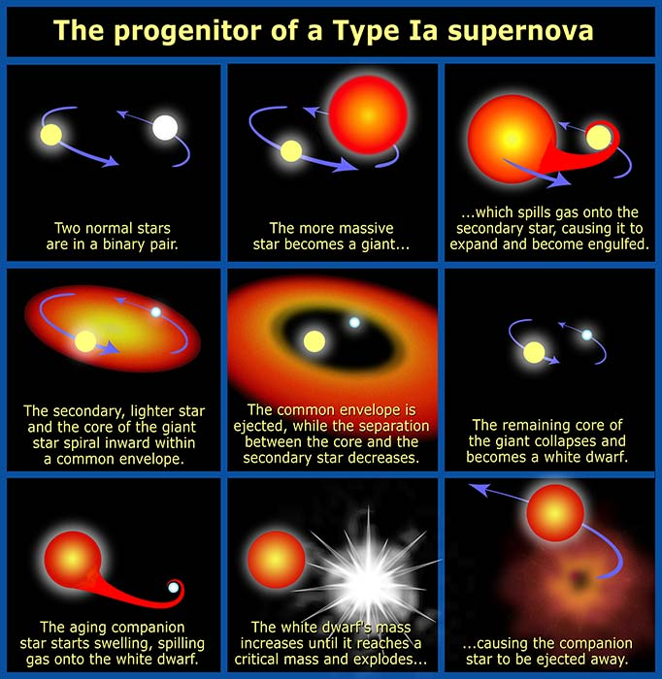
Type Ia supernovae (not other types) make good ‘standard candles’…

Slide 23
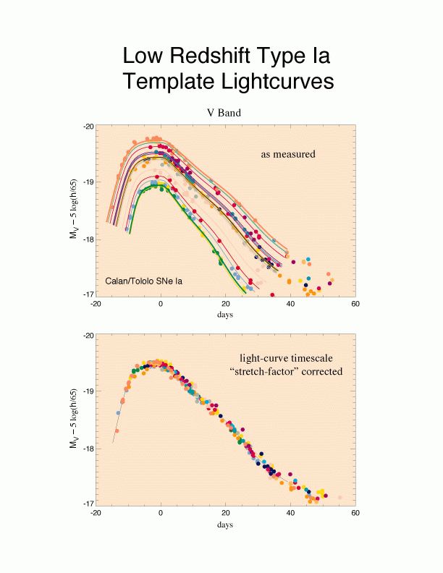

Slide 24
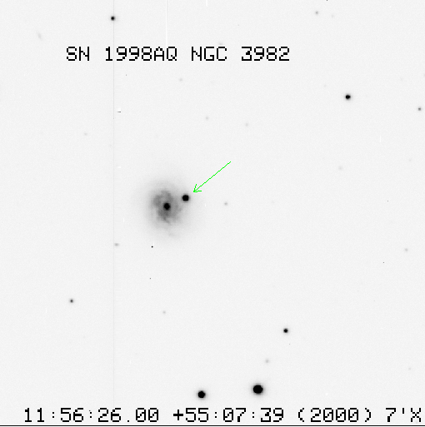
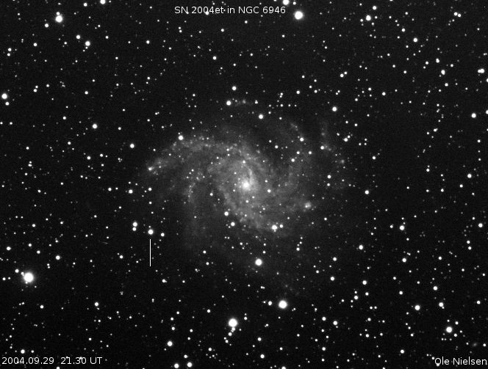
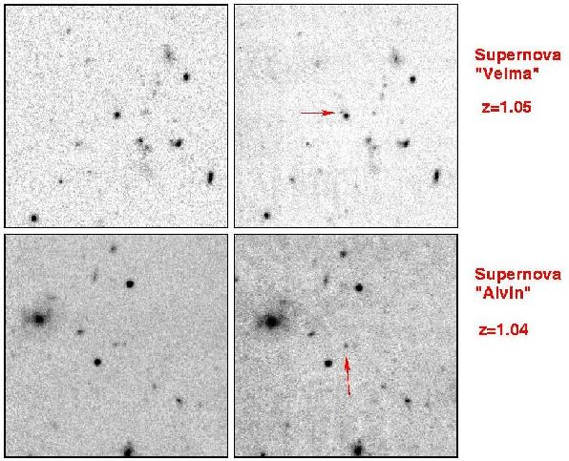
Type Ia Supernovae (SNe Ia) have become the principal distance indicator for the determination of distances in the Hubble flow and, in connection with their calibration through Cepheids, the Hubble constant

